Slide 1
Ancient Rome
Literature Focus Unit
3, 4, 5 Grades
EDU 315
Ms. Cate Zebroski
Notes:
http://histmyst.org/festivals.html festivals
SCHEDULE
PICTURES
THEME STUDY PAGE
Julius Caesar speech & what a research journal entails & what latin are they listening too?

Slide 2
Literature
Fiction:
Roman Diary by Richard Platt & David Parkins
Rotten Romans by Terry Deary
Mira’s Diary: Home Sweet Rome by Marissa Miles
The Assassins of Rome by Caroline Lawrence
See You Later Gladiator by Jon Scieszka
Dorkius Maxius by Tim Collins http://dorkiusmaximus.co.uk/dorkius-world/rome/
Twice Freed by Patricia St. John
A Triumph for Flavius by Caroline Dale Snedeker
Augustus Caesar’s World by Genevieve Foster
Non-Fiction:
Life and Times of Cicero, Life and Times of Nero, Life and Times of Julius Caesar, Life and Times of Constantine by Kathleen Tracy
People Who Made History in Ancient Rome by Patricia Levy
Technology in Times Past: Ancient Rome by Robert Snedden
Look Around A Roman Amphitheatre by Jan Bingham
Top 10 Worst Things About Ancient Rome You Wouldn’t Want to Know by Victoria England
Gladiator by Deborah Murrell
What did the Ancient Romans do for me by Patrick Catel
Your Travel Guide to Ancient Rome by Rita J. Markel
Women in Ancient Rome by Fiona Macdonald
100 Things You Should Know About Ancient Rome by Fiona MacDonald
Ancient Rome and Pompeii by Mary Pope Osborne and Natalie Pope Boyce

Slide 3
Theme Study
Students will partake in a thematic unit on the Ancient Rome.
This unit will integrate reading and writing with social studies, science, math, art, music, and physical education concepts.
Students will develop an understanding of the people of ancient Rome and their daily lives, inventions, buildings, architecture, government, music, and numeration system.

Slide 4
Language Arts Standards
RL.10: Actively engage in group reading activities with purpose and understanding
RI.1: Ask and answers questions to demonstrate understanding of a text, referring explicitly to the text as the basis for answers
W.5: With guidance and support from peers and adults, develop and strengthen writing as needed by planning, revising, and editing
SL.1: Engage effectively in a range of collaborative discussions with diverse partners building on others’ ideas and expressing their own clearly

Slide 5
Language Arts: Reading Activities
Students will read Roman Myths online.
http://rome.mrdonn.org/romangods/index.html
http://rome.mrdonn.org/myths.html
Students will read various fiction and non-fiction books about Ancient Rome through silent reading, partner reading, guided reading, and reading aloud.
Students will examine text features of nonfiction and informational texts.
Students will read and research historic events of the Roman Empire, daily life, and different classes of people.

Slide 6
Language Arts: Writing Activities
Students will write a creation myth of how our school or our town as founded after listening to the story of Romulus and Remus.
Students will write a poem from the perspective of an animal in the Colosseum.
Students will write a short play about a daily scene in Rome.
the market, the baths, Colosseum, Circus
Students will research famous Romans and write a short biography.
Students will keep a Rome Research journal to organize all the new knowledge they are finding in research.
Students will write on sticky notes events that should be placed on our class timeline.
Notes:
1. Cicero, Constantine, Nero, Julius Caesar,
** write rules on a scroll and have students vote on them
** write a to do list like Caesar
*

Slide 7
Language Arts: Speaking Activities
Students will present their short biographies written on scrolls and present as if in an amphitheater.
Students will be introduced to Latin through learning root words, recognizing English words that are Latin, and Latin words they can recognize.
Students will speak new Latin words in small group dialogues.
Students will speak their assigned parts of a play written in groups. The plays will be based on a daily scene of Roman life.
Students will speak to the class and in group discussions during a Student Senate simulation.
Notes:
English words that are Latin: do, color, condo, quiet, honor, multi, sane, insane, ridiculous, rare, unique, accuse, apparatus, pauper, furor, farina
Latin words to recognize: intorduco, immenso, magnificus, absentis, hilaris, accelero, gloria, humanus, excellentia, frivolus, delectiablis, rudis, miserabilus, offero, publicus, voluntarus, respondo, occuro, necessarius

Slide 8
Language Arts: Listening Activities
Students will listen to peers in group discussions.
Students will listen to their peers’ presentations and myths in the author’s chair.
Students will listen to their peers’ play presentations.
Students will listen to Latin recordings.
Students will listen to the teacher read excerpts from Virgil’s Aenied.
Teacher will read the myth of Romulus and Remus.

Slide 9
Language Arts: Viewing
Students will view and add new Roman vocabulary to the classroom word wall.
Students will view a clip from the movie Ben Hur showing the Chariot Race.
Students will list Latin and translated English words in their word study notebooks.
Students will view a video about different lives of people in Rome.
https://www.youtube.com/watch?v=jt9rZcWelbg
When researching the daily lives of Romans, students will watch virtual tour videos
Baths, Roman Forum, Pantheon, Basilicas, Colosseum

Slide 10
Language Arts: Visually Representing Activities
Students will create a timeline of events of the Roman Empire for the classroom.
http://www.schoolsliaison.org.uk/kids/siteactivities/timelinerome.pdf
Students will dress in Roman costumes for their plays representing the different classes of people.
Students will recreate stone arches with sugar cubes.
Students will create a map of their “empire” (their neighborhood).
Students will study how Roman Numerals are used today through their own observations and the teacher’s examples.
Students will recreate Ancient Roman mosaics with magazine paper.

Slide 11
Science Activities
STANDARDS:
4.2.2. Conduct simple investigations to answer questions based on observation
5.3.5. Explain why gravity is called an attracting force.
Students will build arches using sugar cubes.
“ An arch consists of two weaknesses which, leaning on each other, become a strength.” Leonardo Da Vinci
Students will study the importance of gravity in observing an aqueduct system.
Students will study the water cycle and the importance of recycling water by learning about the how and why the Romans used aqueducts. Students will examine the effectiveness of this water system and whether or not it could still be used today.
Notes:
Constellations?
volcano

Slide 12
Social Studies Activities
STANDARDS:
3.1.3 Use a variety of resources (e.g., maps, charts, bar graphs, Internet, books) to gather information about people, places, and events.
3.1.5 Construct time lines (i.e. periods in their own lives and the lives of their family members)
Students will analyze maps of the Roman Empire from different time periods.
http://www.roman-empire.net/maps/map-empire.html
http://wps.ablongman.com/wps/media/objects/262/268312/art/figures/KISH106.jpg
Students will become “Student Senate” members by discussing and attempting to solve an issue within the school or town.
Students will make a Map of their “own empire.”
Students will create a timeline of Ancient Roman events as they research.
Students will identify shelter, transportation methods of everyday people.
Notes:
Maps: 44AD Caesar died, 166 biggest empire was
Senate: the oldest person opens and closes the senate mtg. One by one everyone gets an opportunity to offer ideas and suggestions. A decree is written after an agreement is met.

Slide 13
Math Activities
STANDARDS:
3.MD.5 Recognize area as an attribute of plane figures and understand concepts of area
4.G.2 Classify two-dimensional figures based on the presence or absence of parallel or
perpendicular lines, or the presence or absence of angles of specified size.
Students will practice writing and reading Roman Numerals. Students will determine where Roman Numerals are used today.
Students will create a timeline and understand the concept of time BC and AD.
Students will analyze geometrical shapes (two and three dimensional) that engineers used to build the Pantheon.
Students will measure and sketch angles of the Pantheon.
Notes:
Money
Include roman numeral worksheet
Telling time

Slide 14
Music Activities
STANDARDS: 4.9.1 Know music from various historical periods.
4.6.5 Understand the relationship between music and movement.
4.4.1 Create and arrange music to accompany readings or dramatizations.
Students will perform a pantomime of a Roman battle to their choice of music that emphasizes the mood of the scene.
Students will compare Roman instruments to those we use today.
http://www.tribunesandtriumphs.org/roman-life/roman-music.htm
Notes:
http://factsanddetails.com/world/cat56/sub369/item2067.html

Slide 15
Art Activities
STANDARDS:
4.1.6 Use visual art materials and tools in a safe and responsible manner.
4.4.1 Know that visual art has both a history and specific relationship to various cultures.
4.1.2 Know the different techniques used to create visual art.
Students will create Roman Mosaics
using a color by number template
cutting out squares of color from magazines
cutting out squares shapes of construction paper
online http://gwydir.demon.co.uk/jo/mosaic/mkmosaic.htm
Students will build a Roman road using an aluminum baking dish, soil, toothpicks, string, multiple size stones, gravel, optional plants and water.
Students will make a Roman wax tablet and draw on it.
Notes:
the baths
Make bullas
Make a triumphal arch

Slide 16
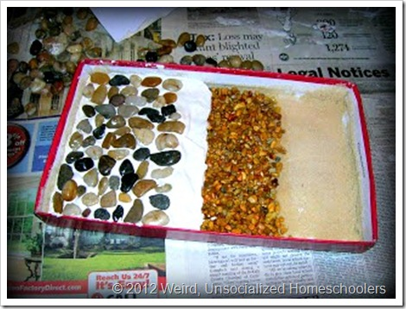
Roman Road
modelshoe box lid
glue or Mod Podge
sand
aquarium gravel
plaster of Paris
smooth stones
1. You’ll build the model by making each layer a little shorter than the last so that you can see each layer. First, we mixed water with Elmer’s glue to make a “paintable” glue (Mod Podge could be substituted here), which we spread all over the bottom of the shoe box lid. Then, we spread a layer of sand over the glue and let it dry for about 30 minutes.
2. Shake off the excess sand, then, paint glue over 3/4 of the sand. Spread the gravel (we used gravel sold for fish tanks) over the glue. We, then, poured the watered down glue over the top of the gravel so that it would hold it all into place. We let this layer dry overnight
3. Use plaster of Paris to represent the concrete. Mix according to package directions, then, cover half of the box with the plaster.
4. While the is still soft, add “paving stones.” Ours were decorative stones from the craft/candle section of Wal-mart. If I had it to do over again, I would have bought larger, smoother stones and I would have let the plaster set just a bit longer. (Also, I think the kids should have put the rocks closer together, but I was trying to leave them alone and let this be their project.)
http://www.weirdunsocializedhomeschoolers.com/how-to-build-roman-road/

Slide 17
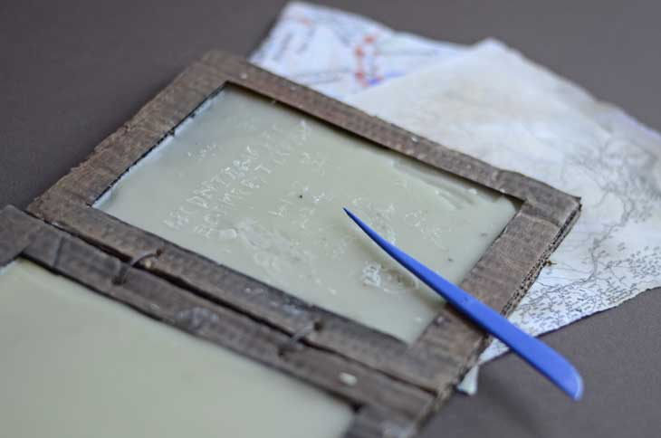
Wax Tablets
cardboard
glue
scissors
black and brown poster paint
wax – melt some old candle stubs, or buy some wax from a craft shop
saucepan and an old bowl or tin
Note: If you do not want to use wax I’m sure some non-drying modelling clay would also work well.
1. First cut out four pieces of cardboard – you could use a paperback book for a template. Using a ruler draw a line 2cm in from the edge of two of the pieces. Cut out the center from these two pieces. Stick them on to the rectangles.
2. Paint the cardboard with a mixture of the brown and black paints to make it look like wood.
3. Make some holes on the edges so you can tie some string through the two tablets. You will have to be careful – get an adult to help.
4. Once the paint has dried you can prepare your wax. You will need an adult to do this part. It needs to be melted in a double boiler – put the wax in the bowl or tin, and place it in the saucepan quarter filled with hot water. The pan can now be gently placed on the stove and the wax will slowly melt.
5. Once it is all melted, brush or pour a thin layer into the space in your tablets. Don’t pour in too much or it will just leak out. Once that has set you can pour another layer on top.
6. Leave the wax to cool down and harden before trying it out.
http://timetravellerkids.co.uk/uncategorized/make-roman-wax-writing-tablet/

Slide 18
Physical Education Activities
STANDARDS:
3.3.3 Participate in moderate to vigorous physical activity
4.5.3 Demonstrate cooperation and respect to others, in small groups, to achieve a common goal during physical activity
Students will participate in chariot races with scooters
Students will train like the Roman Soldiers did with weights and other fitness methods.
Play Roman tag
Students who are IT represent Rome and try to tag the other countries as they race across the gym. Once tagged the students have to join hands with Rome and help them tag the remaing students. This represents the Roman Empire’s expansion.
Play Trigonon
Students stand 10 feet apart at points of a triangle. 3-6 balls are added into play and passed between players in the same direction. More balls are added and the tempo is sped up. If a player misses the ball three times, they’re out. The game continues until one player is left.

Slide 19
Technology
Tours:
http://www.italyguides.it/us/roma/rome_italy_travel.htm
Tour of a Roman Day:
http://www.pbs.org/wgbh/nova/lostempires/roman/day.html
Colosseum:
http://www.bbc.co.uk/history/interactive/animations/colosseum/index_embed.shtml
Research:
http://www.historyforkids.org/learn/romans/
http://www.pbs.org/empires/romans/specialemperor_game.html
http://www.pbs.org/empires/romans/empire/index.html
Videos:
Discovery of Aqueduct Source:
http://news.discovery.com/history/videos/archaeology-ancient-roman-aqueduct-source-discovered.htm
Pictures:
3D Images of Reconstructed Rome
http://romereborn.frischerconsulting.com/gallery-current.php

Slide 20
Language Arts Strategies
Activate Background Knowledge: Students will think about what they already know of Rome.
Consider the Audience: students will adapt their pantomime presentations, myths, plays and biographies to their audience.
Elaborate: students will add details to their creation myths and plays to develop ideas more completely.
Observe: students will examine examples of Ancient Roman mosaics.
Take Notes: students will take notes as they research different aspects of Ancient Rome.
Generate: students will brainstorm ideas, topics for their projects.
Visualizing: students will visualize what it is like to live in Ancient Rome.

Slide 21
Grouping Patterns
Large Group: grand conversations, viewing videos, viewing virtual tours, creating a timeline, Roman Tag, observing the operations of an aqueduct, graphic organizers of Latin words, analyzing and discussing Aqueduct systems, create a word wall, listen to readings of myths and the Aeneid, listening to Latin
Small Group: read to partners, writing and acting out a play, preparing and gathering costumes, Chariot Races, building a Roman Road, performing a pantomime of a Roman battle, comparing musical instruments, Student Senate activity, speaking Latin, dress costumes, playing Trigonon, building an archread fiction and non-fiction texts
Individual: research, reading their myths, taking notes, writing a myth, writing a biography, creating a mosaic, building an arch, fitness training, creating a Roman wax tablet, Roman Numeral practice, analyzing the Pantheon, making their maps, research historic events and people in research people, present biographies, writing poetry, read fiction and non-fiction texts

Slide 22
 | Monday (Foundation) | Tuesday (Empire) | Wednesday (Daily Life) | Thursday (Daily Life) | Friday (Performance)
Language Arts | 1.Teacher will read creation myth of Rome. 2. Students will read other myths online. | 1. Students will write their own creation myth. 2. Latin Lesson | 1.GrandconversationWho lives in Rome? 2.View video of daily life | Revision of myths and biographies | Students will write Colosseum poetry
Social Studies | 1.Grandconversation 2. students will research famous Romans 3. Begin Roman Research Journals | 1. Students will view a maps of the Roman Empire 2. Research and introduce timeline | Begin writing play in groups | Senate Simulation | Play presentations with costumes
PE | Read fiction non-fiction books | Roman tag | 1. View video clip from Ben Hur. 2. Chariot Races | Trigigon Game
Math | Roman Numeral lesson | Concept of timeline | 1. Intro to Pantheon 2. View shapes and design of Pantheon | Measure angles of Pantheon | Roman Numeral Review and Quiz
Art/Music | Students will make wax tablets | Make “own empire maps” | Group Research and Venn diagram of Instruments | Pantomime of Roman Battle | Make Mosaics
Science | 1.Grandconversation of Roman inventions 2.Create roman road | Students will view aqueduct pictures and presentation of gravity | Small Group Virtual tours of baths, Colosseum, Pantheon, Forum | Arches | Students will present myths, biographies, poems in amphitheater

Slide 23
Assessments
Rubrics for writing myth, biographies, poetry, art projects
6+1 writing Trait Assessments, Poetry Numerical Score
Checklist of different features, vocabulary incorporated in play.
Word wall spelling and usage test.
Completion of a Roman Numeral review sheet.
Math geometrical skill assessment.
Observation Check List for active participation and following directions in physical education activities.
Participation in grand conversations and group discussions.
An Archive (portfolio) of all their ancient writings.
Completion of water cycle diagram.
Social Studies map skills assessment.

Slide 24
Aqueducts

Slide 25
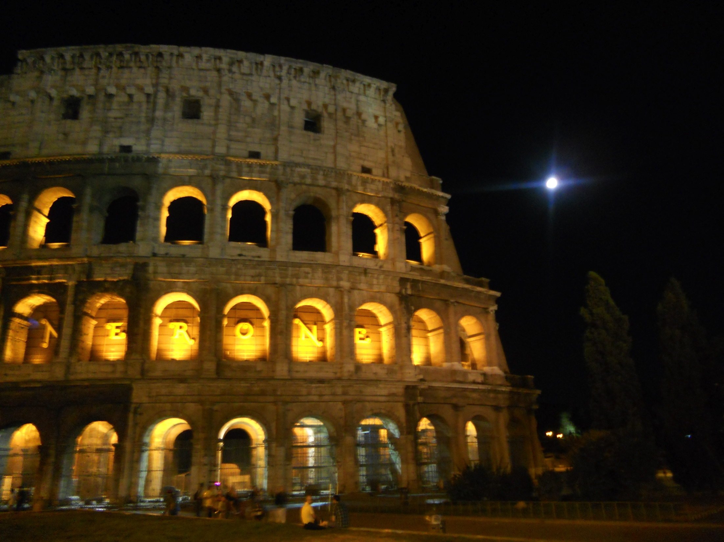
Colosseum

Slide 26
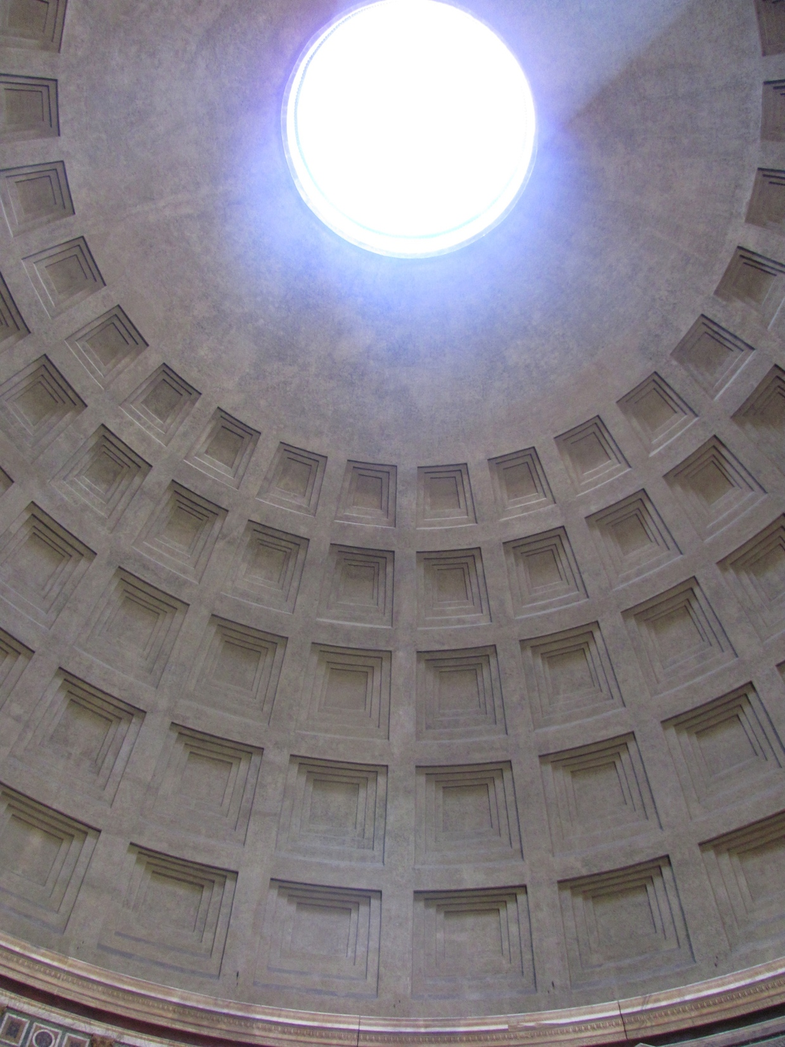
Pantheon

