Slide 1
Promoting Self-Efficacy on the Journey to College & Career Readiness
MiKayla Schuette & Cate Zebroski
University of Mary
Bismarck, ND

Slide 2
Self-Efficacy
Creating internal motivation and confidence in students
Providing skills and knowledge for successful future
Providing experiences to see possibilities for their future
“Everyone should have the resources to envision and develop a positive future story.”
- Ruby Payne, expert of the culture of poverty in education

Slide 3
Why is it important?
Notes:
Self-efficacy is close to our hearts as we have been preparing as preservice teachers. In our personal lives we have seen poverty all over the world and now see it first hand in our district. We have been impressed with individual teachers and schools being proactive to build positive future stories for their kids. Through the School of Education and Behavioral Science Leadership Academy we have had the opportunity to work first hand with some of these passionate teachers.
Start young
Form the whole child
Consistent reinforcement of confidence

Slide 4
Wachter Enrichment Day
Wachter Middle School Enrichment Week
Budgeting games, discussions with High School career counselor, interest surveys, discussion about preparing for scholarships with UMary financial aid representative
Campus Experience
tours of residence halls and classrooms, discussions of financial aid, intramural game, choir, ate in the dining hall
Effects
In the classroom- Reemphasize note taking, organization, and the overall process of learning
Students can see themselves in a college environment
Students understand the work that is necessary for college, but that it is worth it

Slide 5
AVID: Advancement Via Individual Determination
4, 387 schools world wide
North Dakota
Bismarck: Bismarck HS, Wachter Middle School
West Fargo: Cheney Middle School, Liberty Middle School, Sheyenne HS, West Fargo HS
Programs in Elementary School, Middle School, High School, College
“To close the achievement gap by preparing all students for college readiness and success in a global society.”

Slide 6
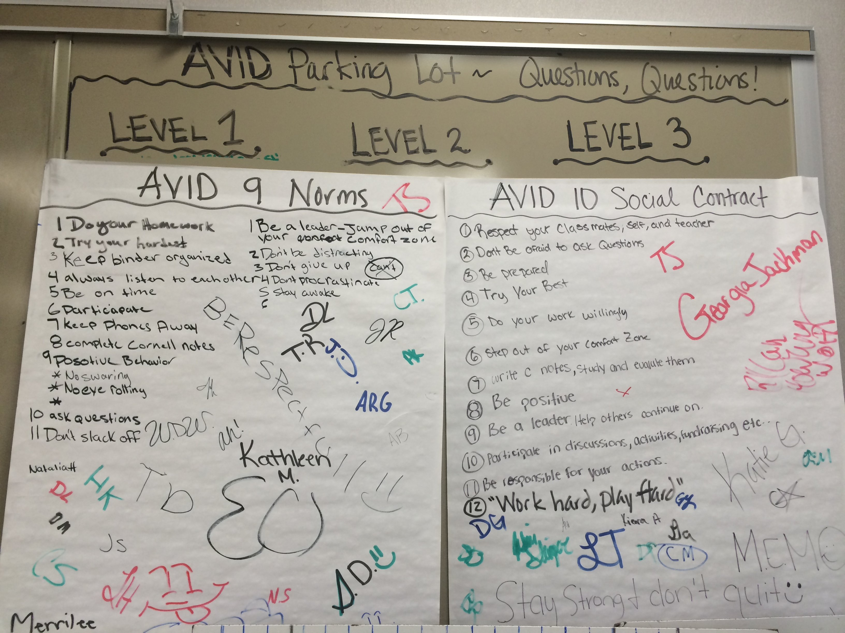
Structure
Note-taking
Tutorials
Tutors
Lesson Plans
Critical Thinking
and Questioning
Accountability
Sense of Belonging

Slide 7
No Excuses University
National Program
every student is capable of learning and going to college if that’s what they choose, no excuses
No Excuses University is a network of schools that collaborate and decide how to prepare each student for college
200 schools nation wide
Apply
receive staff development and on site training
must implement their Six Exceptional Steps
Culture of Universal Achievement, Collaboration, Standards Alignment, Assessment, Data Management, Interventions

Slide 8
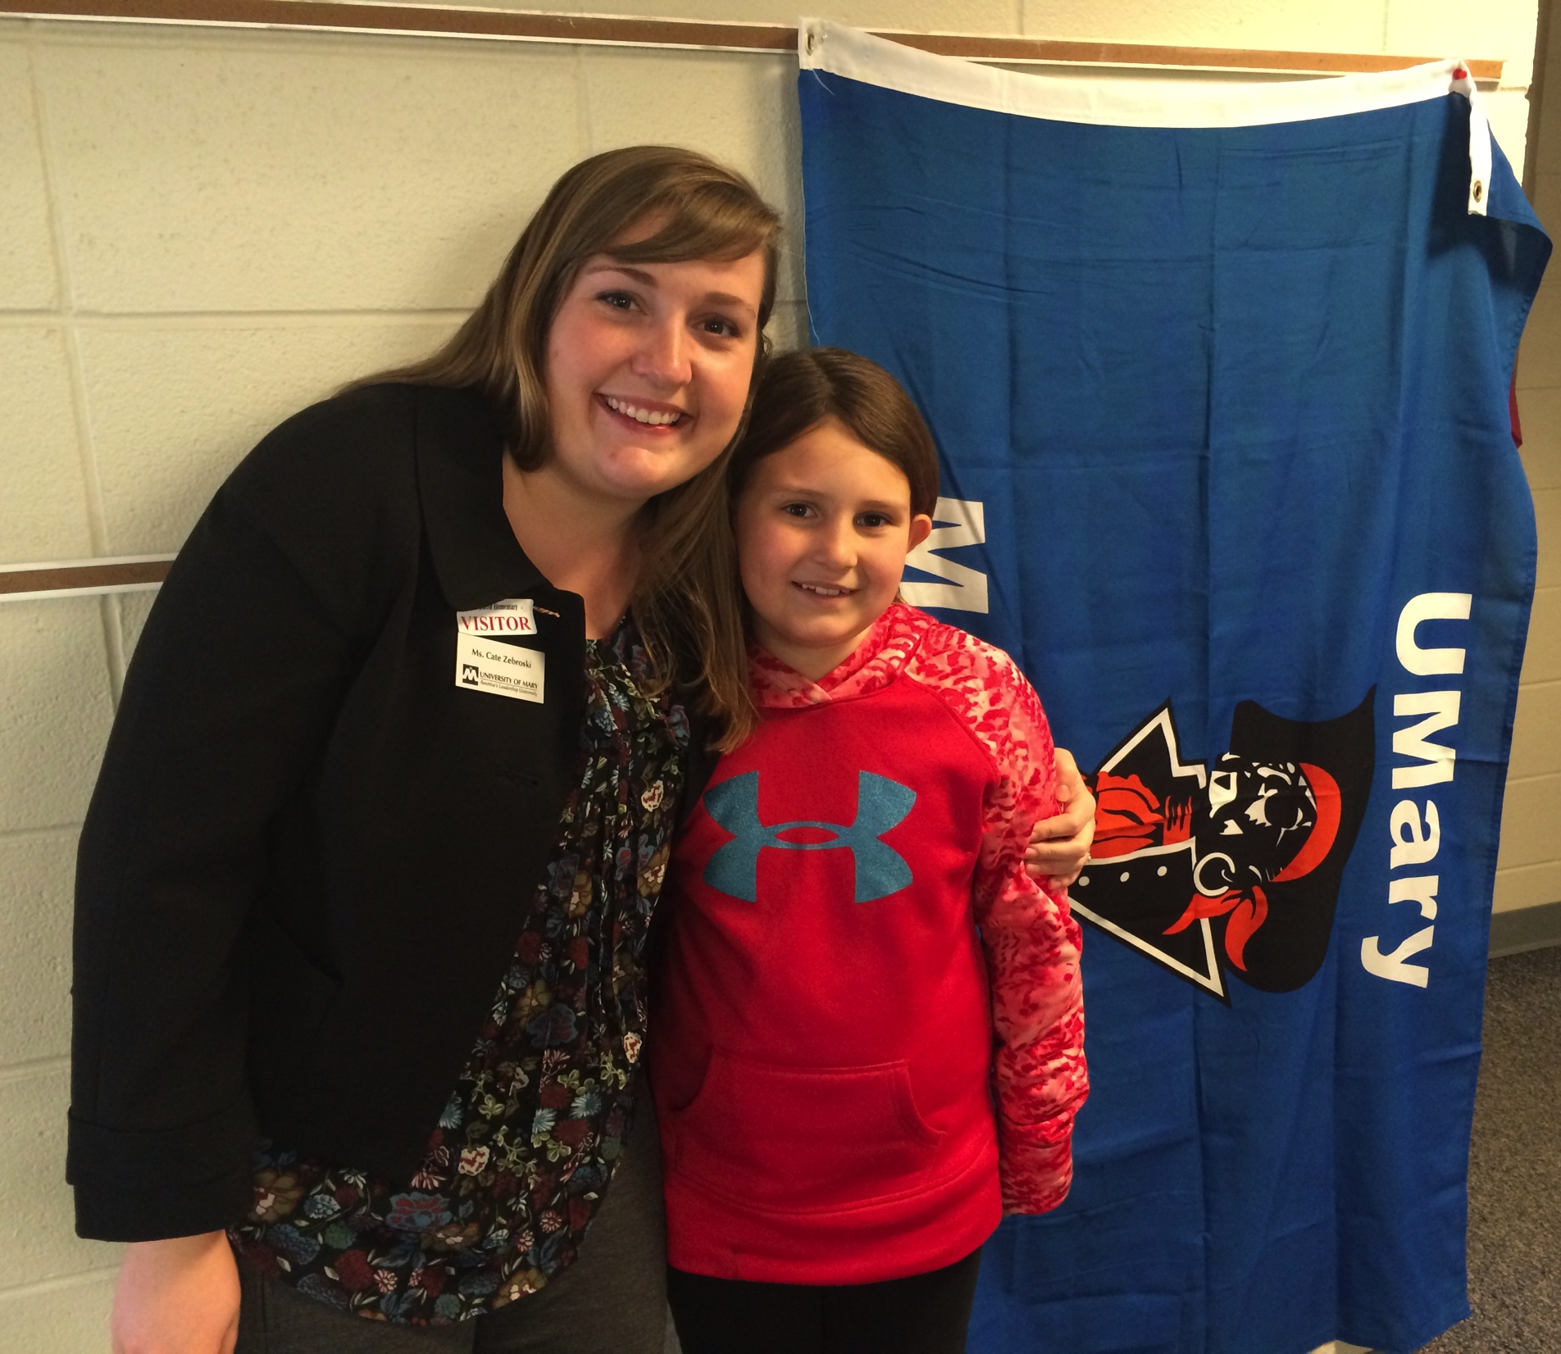
Our Role
School wide
Each classroom collaborates with a different University
Monthly Goals and College Fair
School Spirit
Student lead conferences
Notes:
Important to get our students to think about the future although they may not have been taught, often future doesn’t seem certain. So it is our job as educators to create the certainty for success for our students. We hope we have given you some examples/ways that you can implement them into your classrooms now or your future classrooms. We encourage you to research more ways to promote self-efficacy or go see how teachers in your area are doing it already.

